Slide 1
Unit 3 Inheritance and Polymorphism
Inheritance: Introduction, Need of Inheritance, Types of Inheritance, Benefits of Inheritance, Cost of Inheritance, Constructors in derived Classes, Method Overriding, Abstract Classes and Interfaces.
Polymorphism and Software Reuse: Introduction, Types of Polymorphism (Compile Time and Run Time Polymorphism), Mechanisms for Software Reuse, Efficiency and Polymorphism

Slide 2
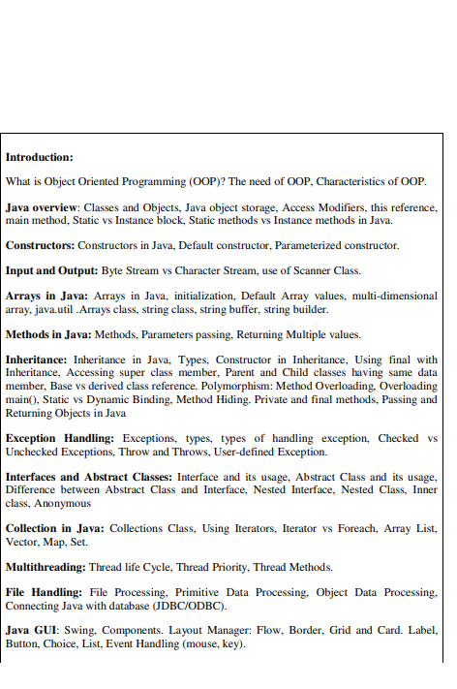

Slide 3
Lect. No. | Content | Book | Page No.
1 | Introduction, Need of Inheritance, Types of Inheritance | T2 | 350
2 | Benefits of Inheritance | T1 | 178
3 | Cost of Inheritance | T1 | 180
4 | Constructors in derived Classes, | T1 | 176
5 | Method Overriding | T1,T2 | 167,354
6 | Abstract Classes and Interfaces | T1 | 169
7 | Introduction, Types of Polymorphism (Compile Time and Run Time Polymorphism) Mechanisms for Software Reuse, Efficiency and Polymorphism | T1 | 273-281
Text Books:
1. An Introduction to Object Oriented Programming (3rd Ed), by Timothy A. Budd, published by Addison-Wesley,2002
2. E. Balaguruswamy, “Object Oriented Programming Using C++ and Java”, Tata McGrawHill

Slide 4
Inheritance

Slide 5
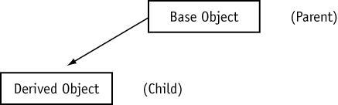
Inheritance
What is Inheritance?
It allows a new class to be based on an existing class. The new class inherits all the member variables and functions of the class it is based on.

Slide 6
Inheritance
A derived class extends a base class. It inherits all of its methods (behaviors) and attributes (data) and it may have additional behaviors and attributes of its own.
Derived class
Base class
class B extends A
class A
attributes inherited from base
Base class attributes
Additional attributes
methods inherited from base
Base class methods
Additional methods

Slide 7
Inheritance
Inheritance is mechanism of extending the functionality from one class to another.
The original class is called as base/super/parent class.
The new class with extended functionality is called as derived/sub/child class.
Derived class can inherit features of base class & add its own unique features, thus it supports concept of reusability.

Slide 8
“Person” is a generalization of “Student”. “Student” is a specialization of “Person”.
Person
Name
Age
Mobile no.
Student
Reg. No.
Branch
Marks
Teaching Staff
Qualification
Designation
Specialization

Slide 9
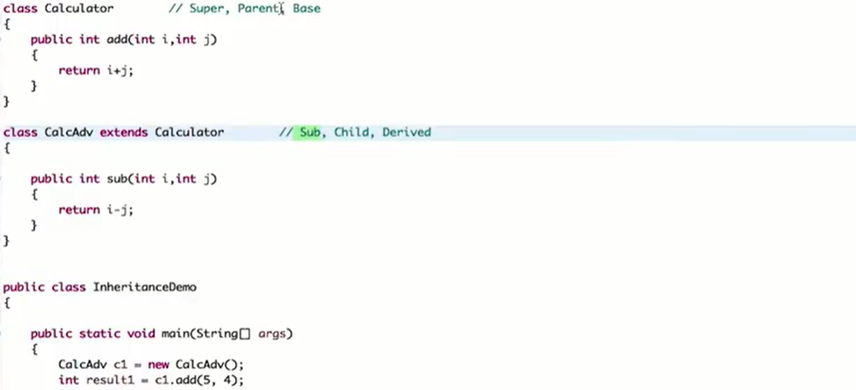

Slide 10
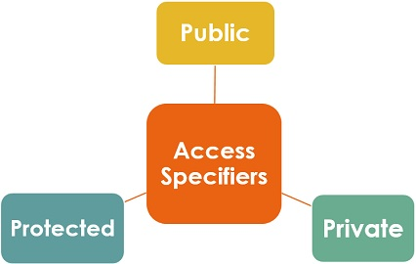

Slide 11
Access specifiers
Public
Private
Protected

Slide 12
Class B extends A //java
Class B: public A //c++
class derived_class : Access_specifier base_class
{
// Body of derived class
};
Access specifier is optional, default access specifier is public.

Slide 13
Access Specifiers
13

Slide 14
14

Slide 15
15

Slide 16
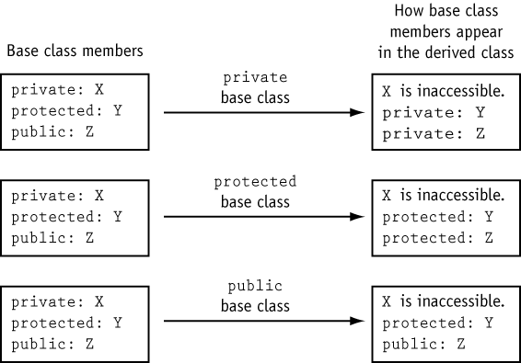
16

Slide 17
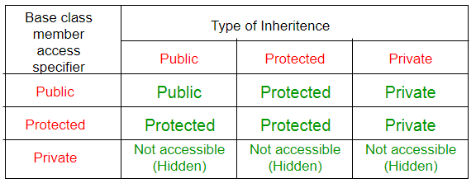

Slide 18
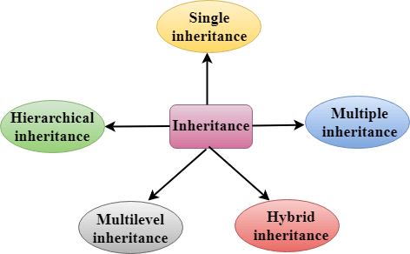
Types of Inheritance

Slide 19
Types of Inheritance
Single Inheritance
Class inherits from one base class
Multiple Inheritance
Class inherits from multiple base classes
Multilevel inheritance
Class inherits from multilevel base classes
Hierarchical Inheritance
single base class & multiple derived classes.
Hybrid Inheritance
Multilevel & multiple base classes

Slide 20
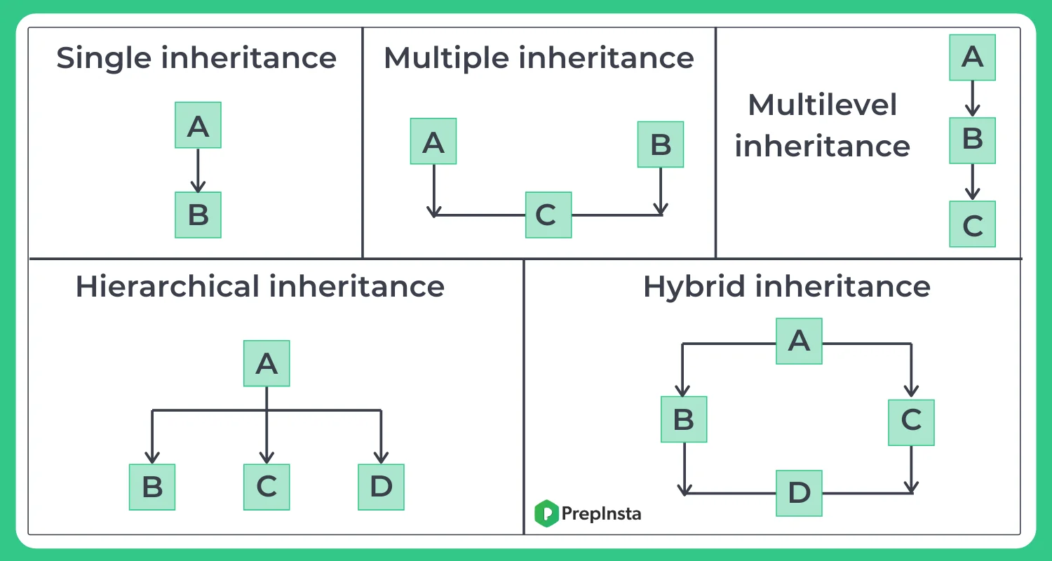

Slide 21
Single Inheritance
It consist of single base & single derived class.
Derived class inherits all protected & public members.
Private members will not be derived.
class B: public A
{
}

Slide 22
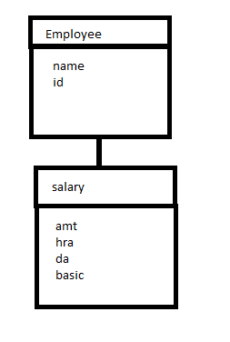
Write a C++ program to illustrate single inheritance.

Slide 23
class employee
{ protected:
char Name[10];
int id;
};
class salary : public employee
{
int amt,hra,da,basic;
public:
void accept();
void display();
};

Slide 24
void salary :: accept()
{
cout<<“\nEnter Name,Id,hra,da,basic”;
cin>>Name>>id>>hra>>da>>basic;
}
void salary :: display()
{
cout<<Name<<id<<hra<<da<<basic;
amt=hra+da+basic;
cout<<amt;
}

Slide 25
int main()
{
salary ob;
ob.accept();
ob.display();
}

Slide 26
Multiple inheritance
Multiple base classes & single derived class
Derived class inherits all protected & public members of multiple base classes.

Slide 27
class test
{
void show(int a)
{
System.out.println("int method");
}
void show(int... a)
{
System.out.println("varargs method");
}
}
public class Main
{
public static void main(String[] args) {
test ob=new test();
ob.show(10); //output: int method
}
}

Slide 28
class test
{
void show(int a)
{
System.out.println("int method");
}
void show(int... a)
{
System.out.println("varargs method");
}
}
public class Main
{
public static void main(String[] args) {
test ob=new test();
ob.show(10,20,30,40,50); //output: varargs method
}
}

Slide 29
class test
{
void show(int a)
{
System.out.println("int method");
}
void show(char... a)
{
System.out.println("varargs method");
}
}
public class Main
{
public static void main(String[] args) {
test ob=new test();
ob.show('p','q','r','t');
}
}

Slide 30
class D is derived from base classes A B and C.
class A // base class A
{
};
class B // base class B
{
};
class C // base class C
{
};
class D : public A, public B, public C // C is derived from A B and C
{
};

Slide 31
Constructors & Destructors in Inheritance
The base class’s constructor is called before the derived class’s constructor.
The destructors are called in reverse order, with the derived class’s destructor being called first.

Slide 32
class Base
{ public:
Base()
{ cout << "This is the Base constructor.\n"; }
~Base()
{ cout << "This is the Base destructor.\n"; }
};
class Derived : public Base
{ public:
Derived()
{ cout << "This is the Derived constructor.\n"; }
~Derived()
{ cout << "This is the Derived destructor.\n"; }
};
int main()
{ Derived object; }

Slide 33
Program Output
This is the Base constructor.
This is the Derived constructor.
This is the Derived destructor.
This is the Base destructor.

Slide 34
Constructors in multiple inheritance
class A
{ public:
A() { cout<<“A’s constructor called”; }
~A() { cout<<“A’s Destructor called”; }
};
class B
{ public:
B() { cout<<“B’s constructor called”; }
~B() { cout<<“B’s Destructor called”; }
};
Class C: public B, public A
{ public:
C() { cout<<“C’s constructor called”; }
~C() { cout<<“C’s Destructor called”; }
};
int main()
{ C obj; }

Slide 35
Output:
B’s constructor called
A’s constructor called
C’s constructor called
C’s Destructor called
A’s Destructor called
B’s Destructor called
The constructor of inherited classes are called in the same order in which they are inherited.
The destructor are called in reverse order of constructors.

Slide 36
Multilevel inheritance
It consist of chain of classes in which one class can act as base as well as derived.
It consist of class that is derived from another derived class.
Derived class inherits features from its immediate super class in hierarchy.

Slide 37
Multilevel inheritance
class A //grandfather
{
}
class B: public A //father
{
}
class C : protected B //child
{
}

Slide 38
Explain constructors and destructors in inheritance. Write a program to demonstrate how constructor and destructors are invoked in multilevel inheritance. [6]

Slide 39
Constructors in Multilevel inheritance
class A
{ public:
A() { cout<<“A’s constructor called”; }
~A() { cout<<“A’s Destructor called”; }
};
class B: public A
{ public:
B() { cout<<“B’s constructor called”; }
~B() { cout<<“B’s Destructor called”; }
};
Class C: public B
{ public:
C() { cout<<“C’s constructor called”; }
~C() { cout<<“C’s Destructor called”; }
};
int main()
{ C obj; }

Slide 40
Output:
A’s constructor called
B’s constructor called
C’s constructor called
C’s Destructor called
B’s Destructor called
A’s Destructor called
The constructor of inherited classes are called in the same order in which they are inherited.
The destructor are called in reverse order of constructors.

Slide 41
Hierarchical inheritance
It consist of single base class & multiple derived classes.
All the derived classes inherits all protected & public members from single base class.

Slide 42
Hierarchical inheritance
class A
{
};
class B: public A
{
};
class C: public A
{
};
class D: public A
{
};

Slide 43
Hybrid inheritance
class A
{
};
class B: public A
{
};
class C: public A
{
};
class D: public B, protected C
{
};

Slide 44
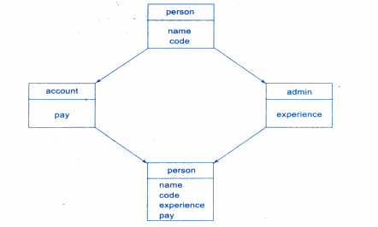

Slide 46
class Person {
public:
Person() { cout << "Person::Person(int ) called” }
};
class Faculty : public Person {
public:
Faculty():Person(x) {
cout<<"Faculty::Faculty(int ) called”;
}
};
class Student : public Person {
public:
Student():Person(x) {
cout<<"Student::Student(int ) called”;
}
};
class TA : public Faculty, public Student {
public:
TA(): Student(x), Faculty(x) {
cout<<"TA::TA() called";
}
};

Slide 47
int main() {
TA ob;
}
Person::Person() called
Faculty::Faculty() called
Person::Person() called
Student::Student() called
TA::TA() called

Slide 48
Single Inheritance

Slide 49
class A
{
void showA()
{
System.out.println("A class show method");
}
}
public class B extends A
{
void showB()
{
System.out.println("B class show method");
}
public static void main(String[] args) {
A ob1=new A();
ob1.showA();
//ob1.showB();
System.out.println("---------------------------------------");
B ob2=new B();
ob2.showA();
ob2.showB();
}
}

Slide 50
Multilevel Inheritance

Slide 51
class A
{
void showA()
{
System.out.println("A class show method");
}
}
class B extends A
{
void showB()
{
System.out.println("B class show method");
}
}
public class C extends B
{
void showC()
{
System.out.println("C class show method");
}
public static void main(String[] args) {
A ob1=new A();
ob1.showA();
//ob1.showB();
//ob1.showC();
B ob2=new B();
ob2.showA();
ob2.showB();
//ob2.showC();
C ob3=new C();
ob3.showA();
ob3.showB();
ob3.showC();
}
}

Slide 52
Hierarchical Inheritance

Slide 53
class A
{ void showA()
{
System.out.println("A class show method");
}
}
class B extends A
{ void showB()
{
System.out.println("B class show method");
}
}
public class C extends A
{ void showC()
{
System.out.println("C class show method");
}
public static void main(String[] args) {
A ob1=new A();
ob1.showA();
//ob1.showB();
//ob1.showC();
B ob2=new B();
ob2.showA();
ob2.showB();
//ob2.showC();
C ob3=new C();
ob3.showA();
//ob3.showB();
ob3.showC();
}
}

Slide 54
Inheritance
Another fundamental object-oriented technique is inheritance, used to organize and create reusable classes
deriving new classes from existing classes
creating class hierarchies
the protected modifier
polymorphism via inheritance
inheritance hierarchies for interfaces
inheritance used in graphical user interfaces

Slide 55
Inheritance
Inheritance allows a software developer to derive a new class from an existing one
The existing class is called the parent class, or superclass, or base class
The derived class is called the child class or subclass.
As the name implies, the child inherits characteristics of the parent
That is, the child class inherits the methods and data defined for the parent class

Slide 56
Inheritance
To tailor a derived class, the programmer can add new variables or methods, or can modify the inherited ones
Software reuse is at the heart of inheritance
By using existing software components to create new ones, we capitalize on all the effort that went into the design, implementation, and testing of the existing software

Slide 57
Inheritance
Inheritance relationships often are shown graphically in a UML class diagram, with an arrow with an open arrowhead pointing to the parent class
Vehicle
Car
Inheritance should create an is-a relationship, meaning the child is a more specific version of the parent

Slide 58
Deriving Subclasses
In Java, we use the reserved word extends to establish an inheritance relationship
class Car extends Vehicle
{
// class contents
}

Slide 59
The protected Modifier
The protected modifier allows a member of a base class to be inherited into a child
Protected visibility provides more encapsulation than public visibility does
However, protected visibility is not as tightly encapsulated as private visibility

Slide 60
The Constructors
Constructors are not inherited, even though they have public visibility

Slide 61
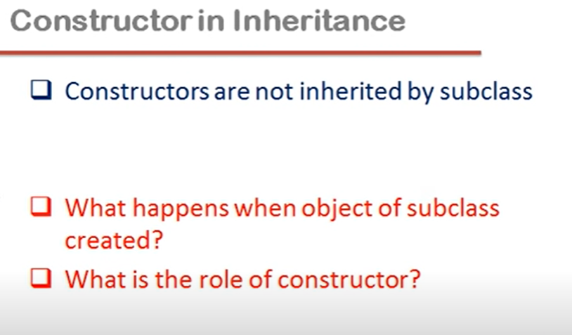

Slide 62
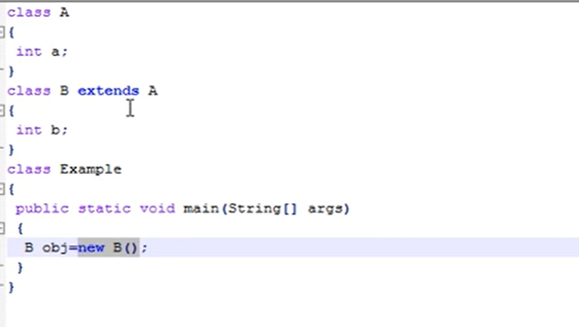

Slide 63
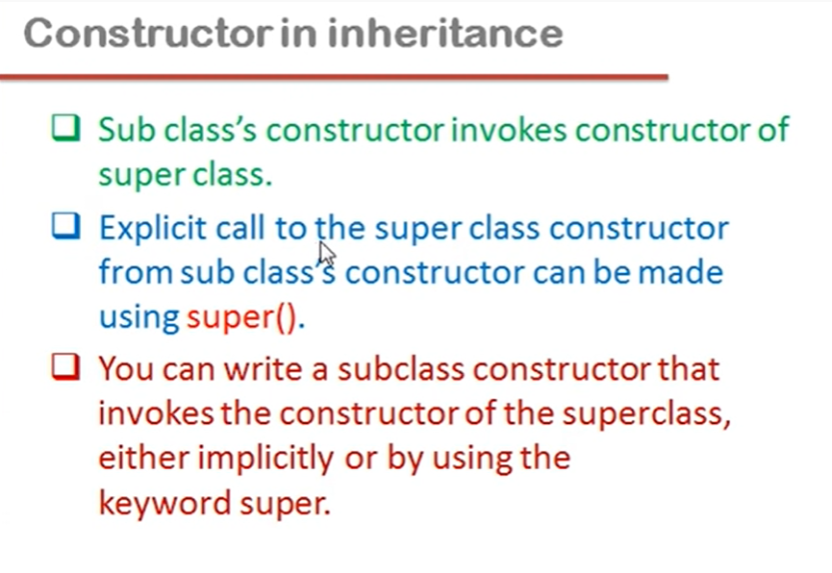

Slide 64
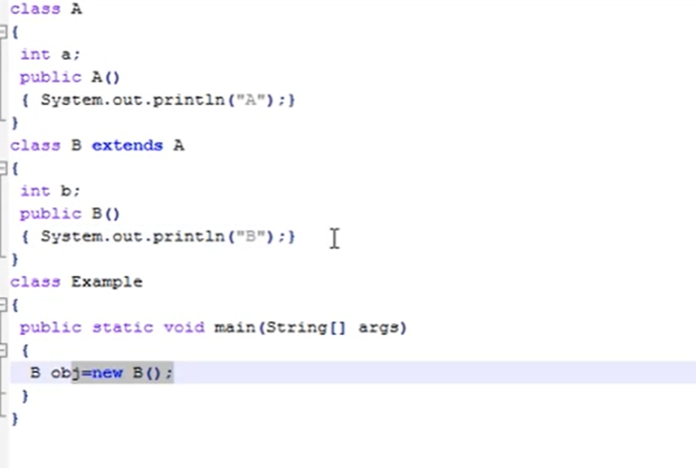

Slide 65
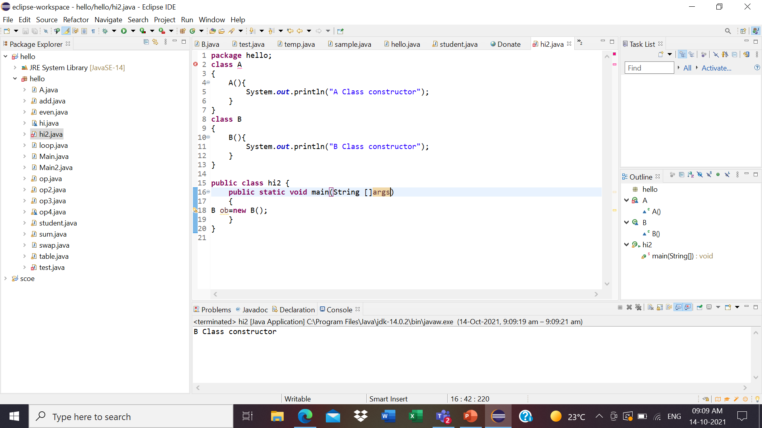

Slide 66
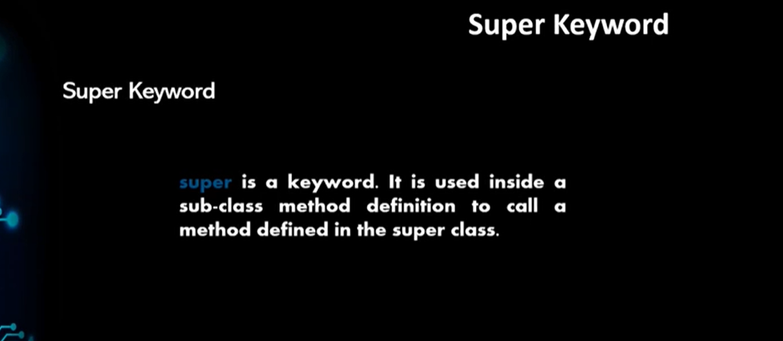

Slide 67
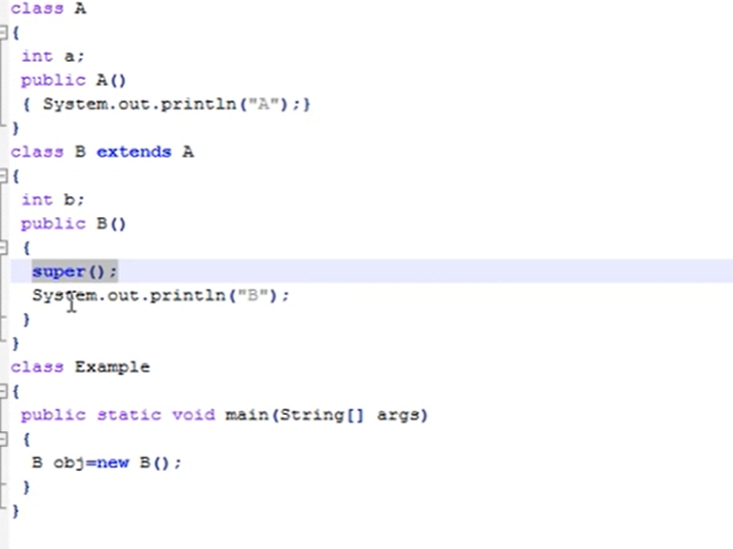

Slide 68
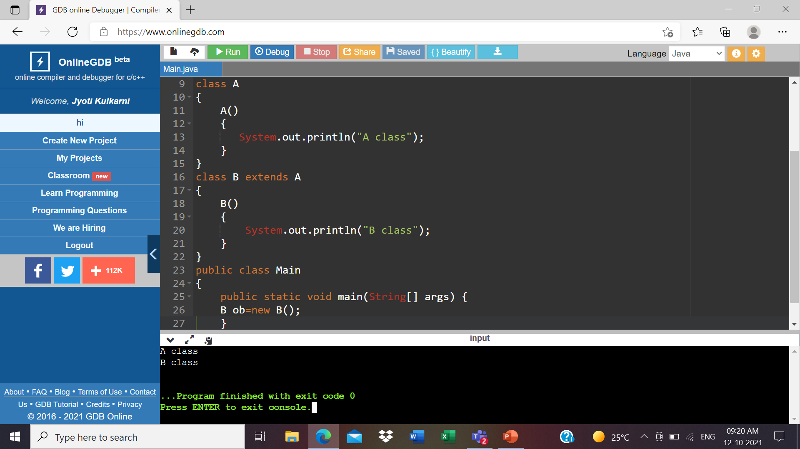

Slide 69
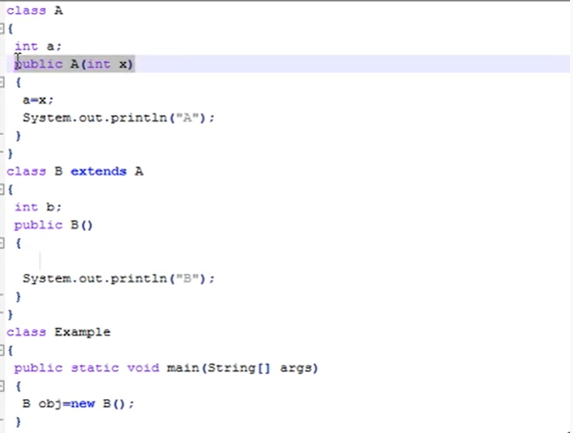

Slide 70
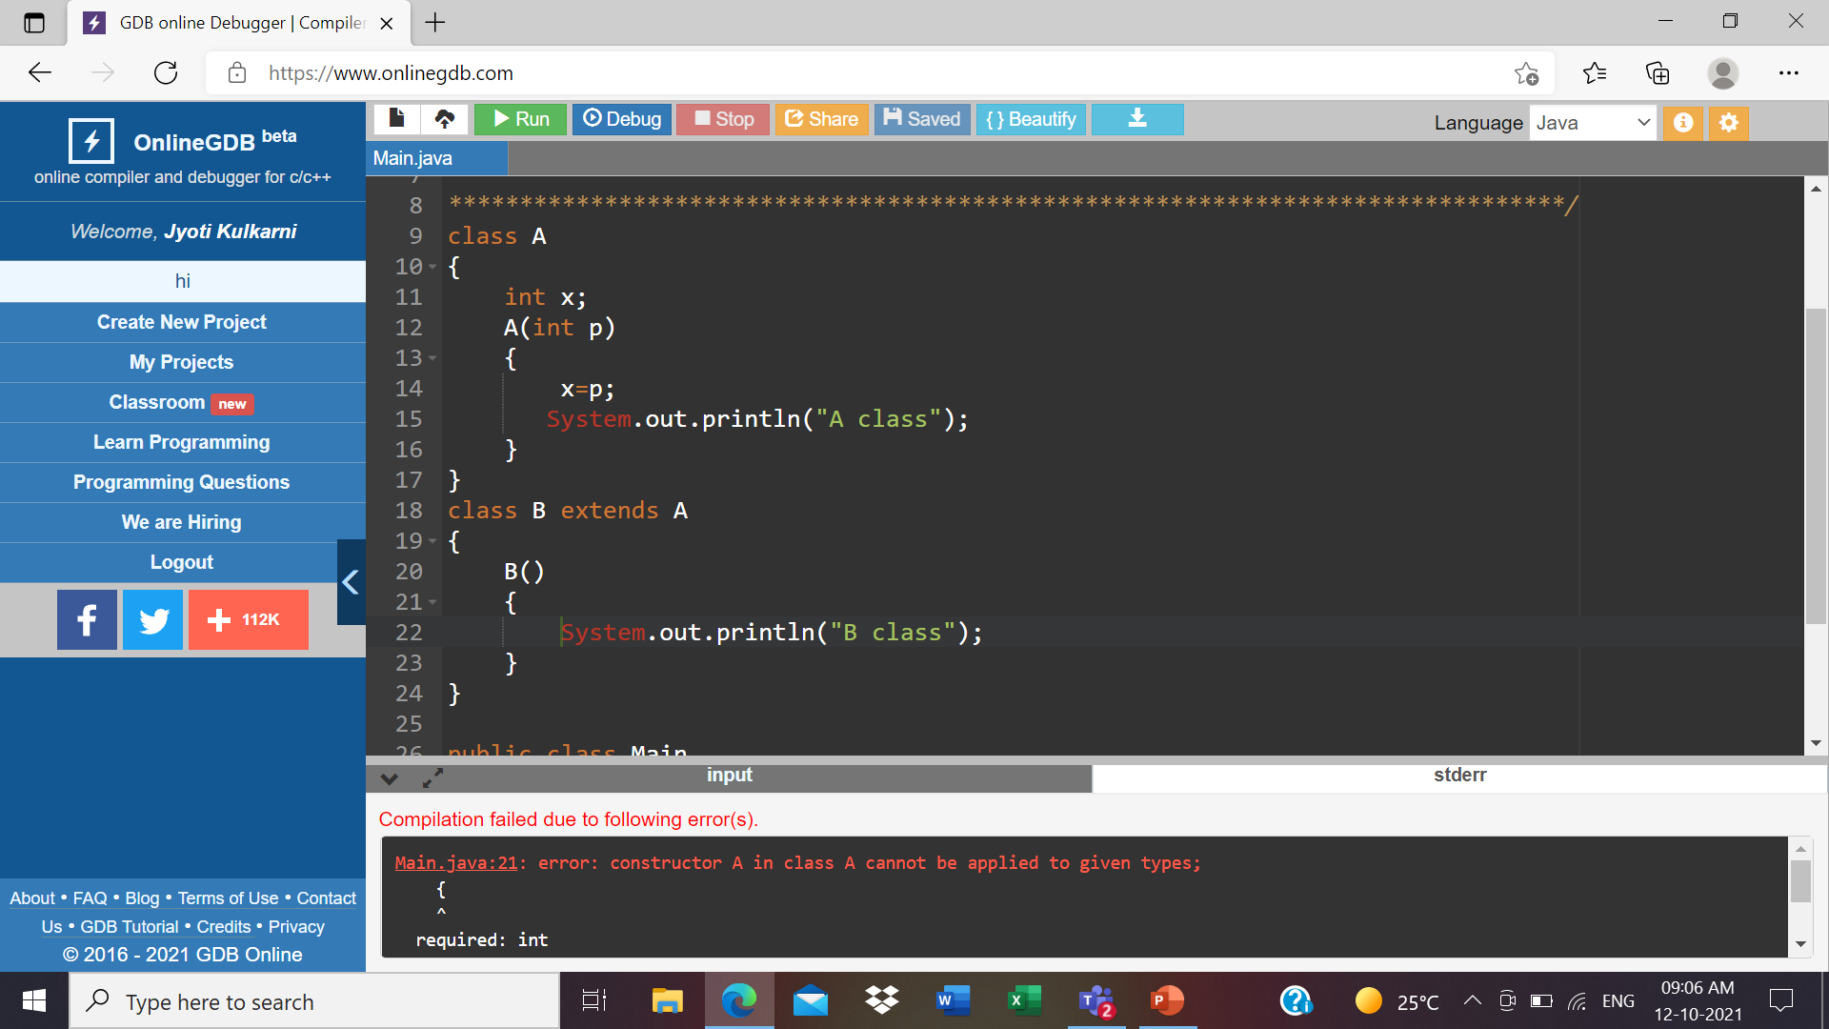

Slide 71
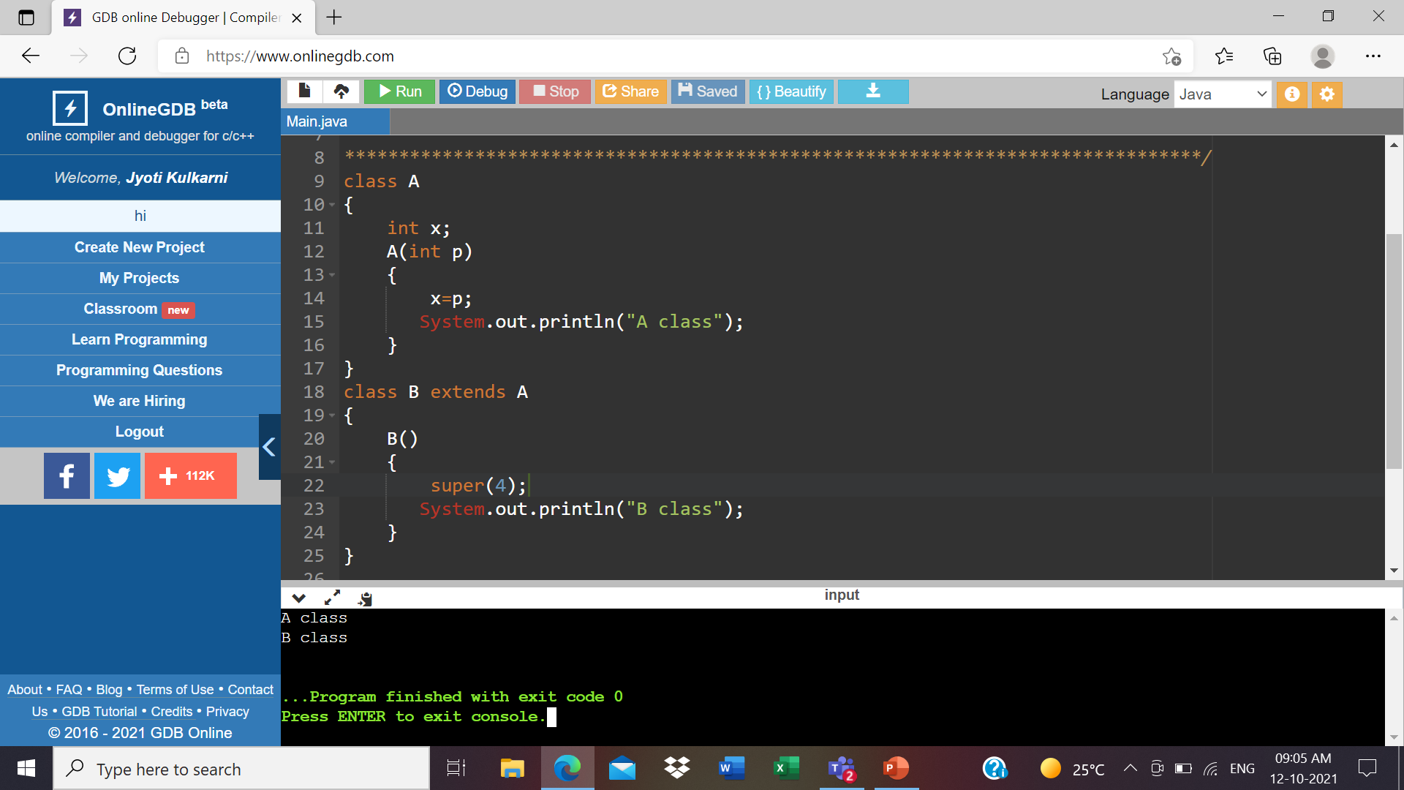

Slide 72
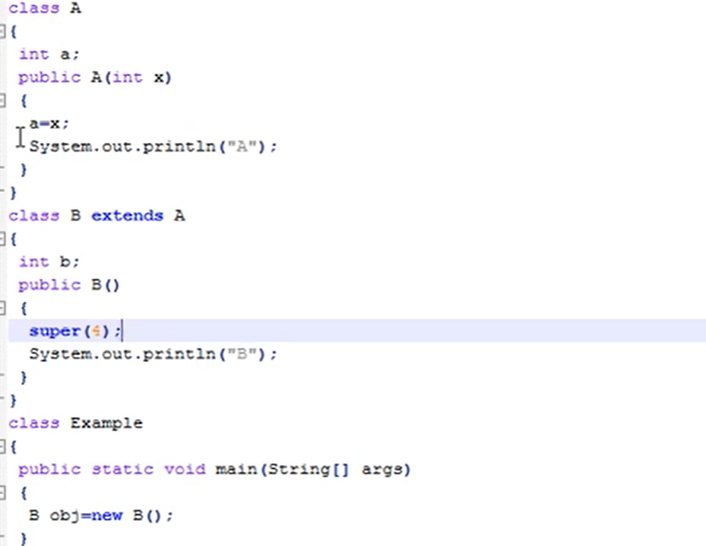

Slide 73
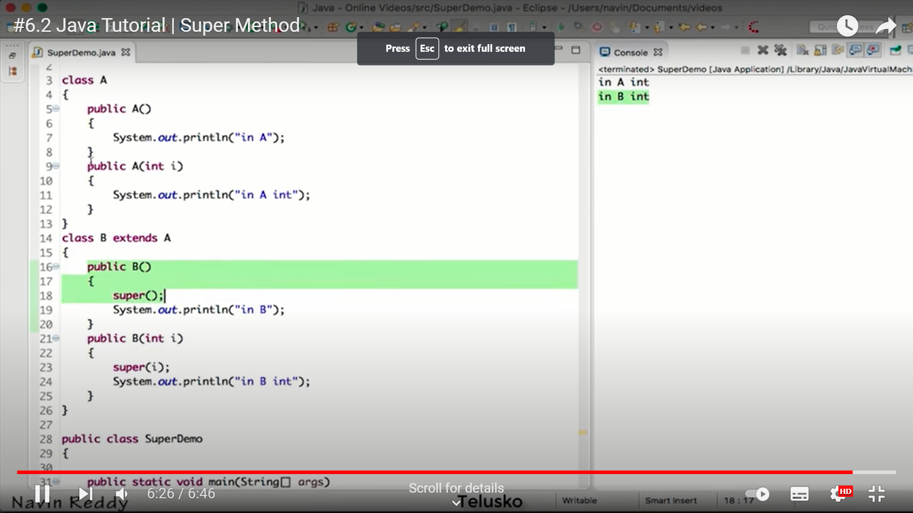

Slide 74
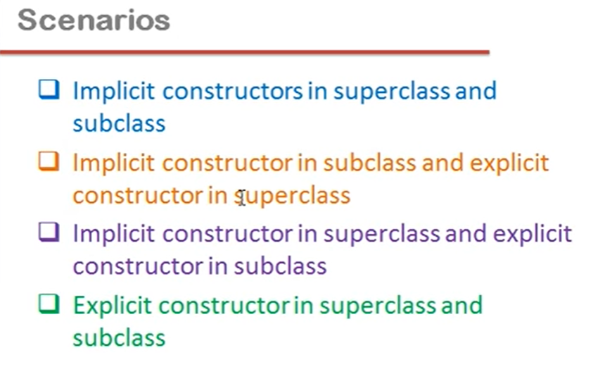

Slide 75
package com.company;
class Base1{
Base1(){
System.out.println("I am a constructor");
}
Base1(int x){
System.out.println("I am an overloaded constructor with value of x as: " + x);
}
}
class Derived1 extends Base1{
Derived1(){
//super(0);
System.out.println("I am a derived class constructor");
}
Derived1(int x, int y){
super(x);
System.out.println("I am an overloaded constructor of Derived with value of y as: " + y);
}
}

Slide 76
class ChildOfDerived extends Derived1{
ChildOfDerived(){
System.out.println("I am a child of derived constructor");
}
ChildOfDerived(int x, int y, int z){
super(x, y);
System.out.println("I am an overloaded constructor of Derived with value of z as: " + z);
}
}
public class cwh_46_constructors_in_inheritance {
public static void main(String[] args) {
// Base1 b = new Base1();
// Derived1 d = new Derived1();
// Derived1 d = new Derived1(14, 9);
// ChildOfDerived cd = new ChildOfDerived();
ChildOfDerived cd = new ChildOfDerived(12, 13, 15);
}
}

Slide 77
Multiple Inheritance
Java supports single inheritance, meaning that a derived class can have only one parent class
Multiple inheritance allows a class to be derived from two or more classes, inheriting the members of all parents
Collisions, such as the same variable name in two parents, have to be resolved
Java does not support multiple inheritance
In most cases, the use of interfaces gives us aspects of multiple inheritance without the overhead

Slide 78
Overriding Methods
A child class can override the definition of an inherited method in favor of its own
The new method must have the same signature as the parent's method, but can have a different body
The type of the object executing the method determines which version of the method is invoked

Slide 79
Overriding
A parent method can be invoked explicitly using the super reference
If a method is declared with the final modifier, it cannot be overridden
The concept of overriding can be applied to data and is called shadowing variables
Shadowing variables should be avoided because it tends to cause unnecessarily confusing code

Slide 80
Overloading vs. Overriding
Don't confuse the concepts of overloading and overriding
Overloading deals with multiple methods with the same name in the same class, but with different signatures
Overriding deals with two methods, one in a parent class and one in a child class, that have the same signature
Overloading lets you define a similar operation in different ways for different data
Overriding lets you define a similar operation in different ways for different object types

Slide 81
Class Hierarchies
A child class of one parent can be the parent of another child, forming a class hierarchy
Business
RetailBusiness
ServiceBusiness
KMart
Macys
Kinkos

Slide 82
Class Hierarchies
Two children of the same parent are called siblings
Common features should be put as high in the hierarchy as is reasonable
An inherited member is passed continually down the line
Therefore, a child class inherits from all its ancestor classes
There is no single class hierarchy that is appropriate for all situations

Slide 83
The Object Class
A class called Object is defined in the java.lang package of the Java standard class library
All classes are derived from the Object class
If a class is not explicitly defined to be the child of an existing class, it is assumed to be the child of the Object class
Therefore, the Object class is the ultimate root of all class hierarchies

Slide 84
The Object Class
The Object class contains a few useful methods, which are inherited by all classes
For example, the toString method is defined in the Object class
Every time we have defined toString, we have actually been overriding an existing definition
The toString method in the Object class is defined to return a string that contains the name of the object’s class together along with some other information

Slide 85
The Object Class
All objects are guaranteed to have a toString method via inheritance
Thus the println method can call toString for any object that is passed to it

Slide 86
The Object Class
The equals method of the Object class returns true if two references are aliases
We can override equals in any class to define equality in some more appropriate way
The String class (as we've seen) defines the equals method to return true if two String objects contain the same characters
Therefore the String class has overridden the equals method inherited from Object in favor of its own version

Slide 87
Abstract Classes
An abstract class is a placeholder in a class hierarchy that represents a generic concept
An abstract class cannot be instantiated
We use the modifier abstract on the class header to declare a class as abstract:
public abstract class Whatever
{
// contents
}

Slide 88
Abstract Classes
An abstract class often contains abstract methods with no definitions (like an interface does)
Unlike an interface, the abstract modifier must be applied to each abstract method
An abstract class typically contains non-abstract methods (with bodies), further distinguishing abstract classes from interfaces
A class declared as abstract does not need to contain abstract methods

Slide 89
Abstract Classes
The child of an abstract class must override the abstract methods of the parent, or it too will be considered abstract
An abstract method cannot be defined as final (because it must be overridden) or static (because it has no definition yet)
The use of abstract classes is a design decision – it helps us establish common elements in a class that is too general to instantiate

Slide 90
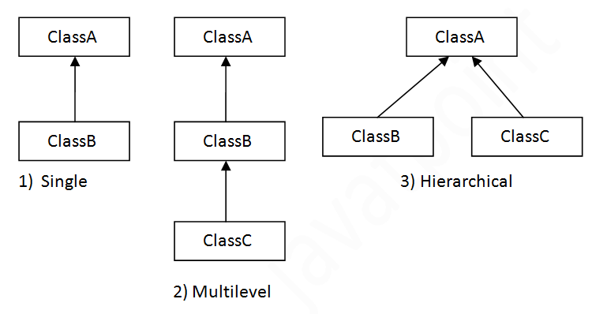
Inheritance & Java implementation
Extends (inheritance between two classes or two interfaces)
Implements (inheritance between a class and interface)
The interface in java enables java to support multiple-inheritance

Slide 91
Benefits of Inheritance
We can reuse the code from the base class.(code reusability)
Using inheritance, we can increase features of class or method by overriding.
Inheritance is used to use the existing features of the class.
It is used to achieve runtime polymorphism i.e method overriding.
Using inheritance, we can organize the information in the hierarchal form.

Slide 92
Cost of Inheritance
Inheritance decreases the execution speed due to the increased time and effort it takes, the program to jump through all the levels of overloaded classes.
Inheritance makes the two classes (base and inherited class) get tightly coupled. This means one cannot be used independently of each other.
The changes made in the parent class will affect the behavior of child class too.
The overuse of inheritance makes the program more complex.

Slide 93
Polymorphism
Compile Time ( Ad-hoc polymorphism): same method with different implementations and different arguments.
Run Time ( Pure Polymorphism) : same method with the same arguments but different implementations. It is also called as Dynamic Dispatch

Slide 94
Run Time Polymorphism / Dynamic Dispatch
Compile Time Polymorphism/ method overloading
class SimpleCalculator{
int add(int a, int b) { return a+b; }
int add(int a, int b, int c) { return a+b+c; }
}
public class Demo
{
public static void main(String args[])
{
SimpleCalculator obj = new SimpleCalculator();
System.out.println(obj.add(10, 20));
System.out.println(obj.add(10, 20, 30));
}
}
class Bike{
void run()
{
System.out.println("running");
}
}
class Splendor extends Bike{
void run()
{
System.out.println("running safely with 60km");
}
public static void main(String args[]) {
Bike b = new Splendor(); //upcasting
b.run();
}
}

Slide 95
Case Study- Banking System
Loan
Personal Loan
Vehicle Loan
FD Loan
Home Loan
Car Loan
Heavy Loan
Mortgage Loan

Slide 96
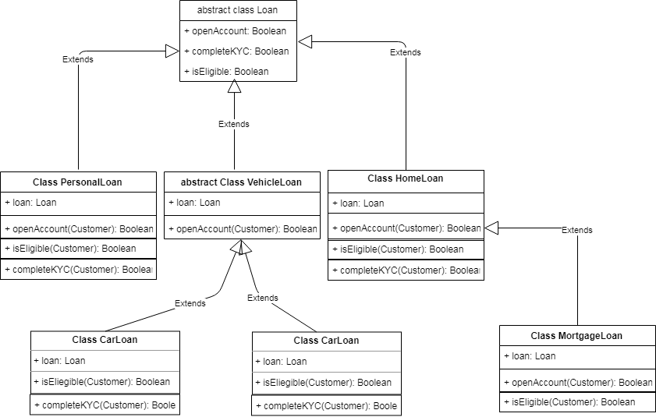
Banking System- Loan Product UML

Slide 97
10 Rules for method overriding
While overriding a method, we must follow the below list of rules.
Static methods can not be overridden.
Final methods can not be overridden.
Private methods can not be overridden.
Constructor can not be overridden.
An abstract method must be overridden.
Use super keyword to invoke overridden method from child class.
The return type of the overriding method must be same as the parent has it.
The access specifier of the overriding method can be changed, but the visibility must increase but not decrease. For example, a protected method in the parent class can be made public, but not private, in the child class.
If the overridden method does not throw an exception in the parent class, then the child class overriding method can only throw the unchecked exception, throwing a checked exception is not allowed.
If the parent class overridden method does throw an exception, then the child class overriding method can only throw the same, or subclass exception, or it may not throw any exception.

Slide 98
8 Rules for method overriding in abstract class
An abstract class must be created with abstract keyword.
An abstract class can be created without any abstract method.
An abstract class may contain abstract methods and non-abstract methods.
An abstract class may contain final methods that can not be overridden.
An abstract class may contain static methods, but the abstract method can not be static.
An abstract class may have a constructor that gets executed when the child class object created.
An abstract method must be overridden by the child class, otherwise, it must be defined as an abstract class.
An abstract class can not be instantiated but can be referenced.

Slide 99
Data Abstraction or Data Hiding
It hides the detailed implementation of an object from user.
The process of extracting the essential information and hiding the irrelevant details to avoid complexity.
Example: Money withdraw from ATM

Slide 100
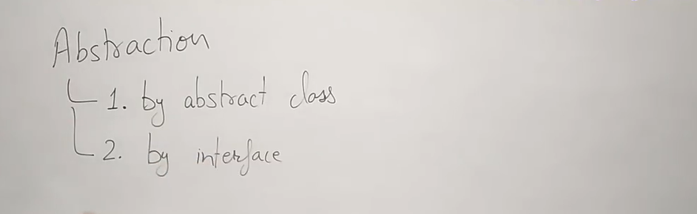

Slide 101
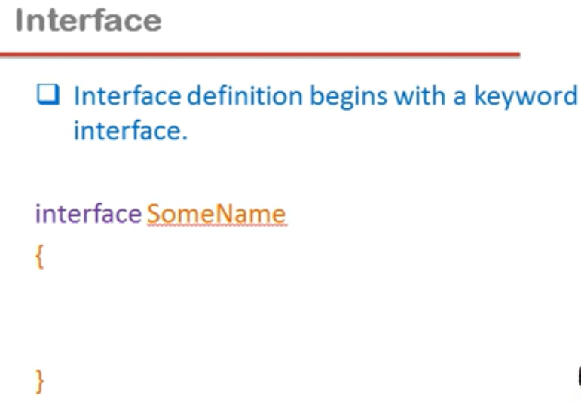

Slide 102
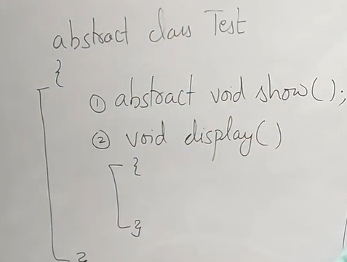
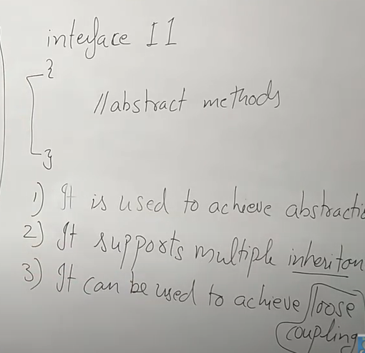

Slide 103
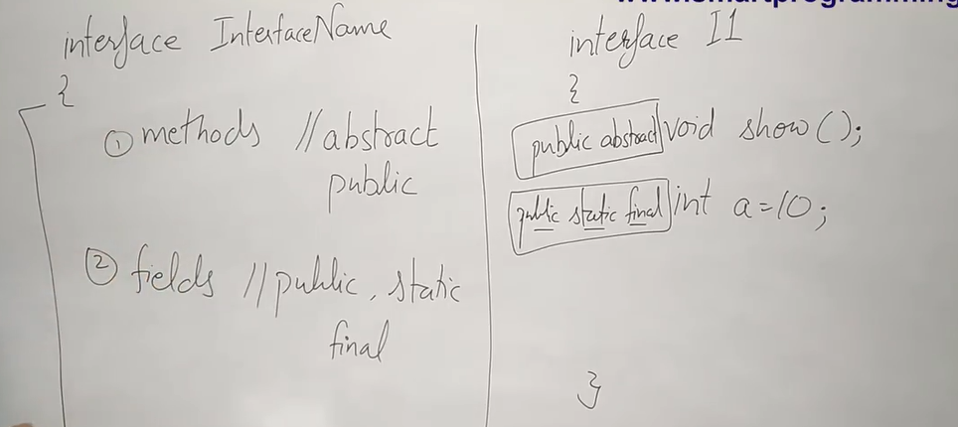

Slide 104
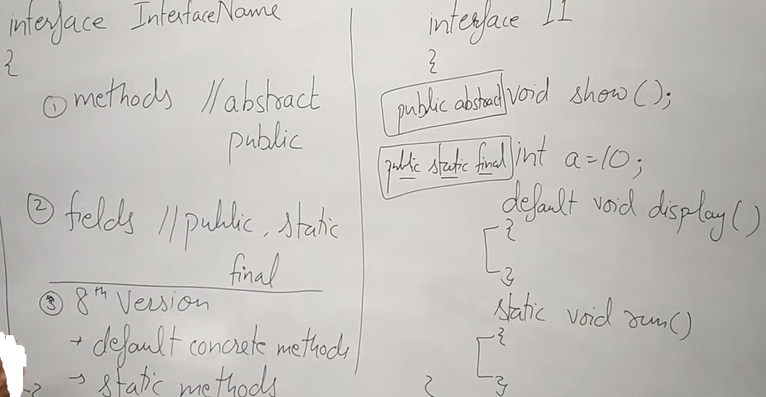

Slide 105
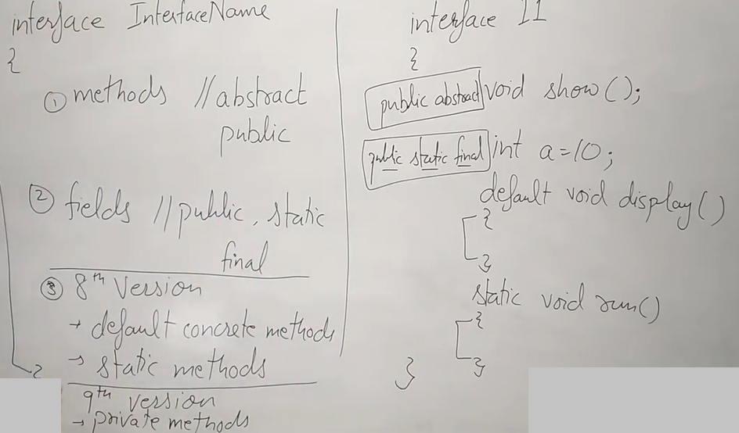

Slide 106
Interface in java
An interface in the Java programming language is an abstract type that is used to specify a behavior that classes must implement.

Slide 107
An interface is an abstract type that is used to specify a behavior that classes must implement. They are similar to protocols.
Interfaces are declared using the interface keyword, and may only contain method signature and constant declarations (variable declarations that are declared to be both static and final).

Slide 108
All methods of an Interface do not contain implementation (method bodies) as of all versions below Java 8.
Starting with Java 8, default and static methods may have implementation in the interface definition.
Then, in Java 9, private and static methods were added. At present, a Java interface can have up to six different types.

Slide 109
Interfaces cannot be instantiated, but rather are implemented.
A class that implements an interface must implement all of the non-default methods described in the interface, or be an abstract class.
Object references in Java may be specified to be of an interface type; in each case, they must either be null, or be bound to an object that implements the interface.

Slide 110
One benefit of using interfaces is that they simulate multiple inheritance.
All classes in Java must have exactly one base class, the only exception being java.lang.Object (the root class of the Java type system); multiple inheritance of classes is not allowed.
However, an interface may inherit multiple interfaces and a class may implement multiple interfaces.

Slide 111
An interface:
declares only method headers and public constants.
cannot be instantiated.
can be implemented by a class.
cannot extend a class.
can extend several other interfaces.

Slide 112
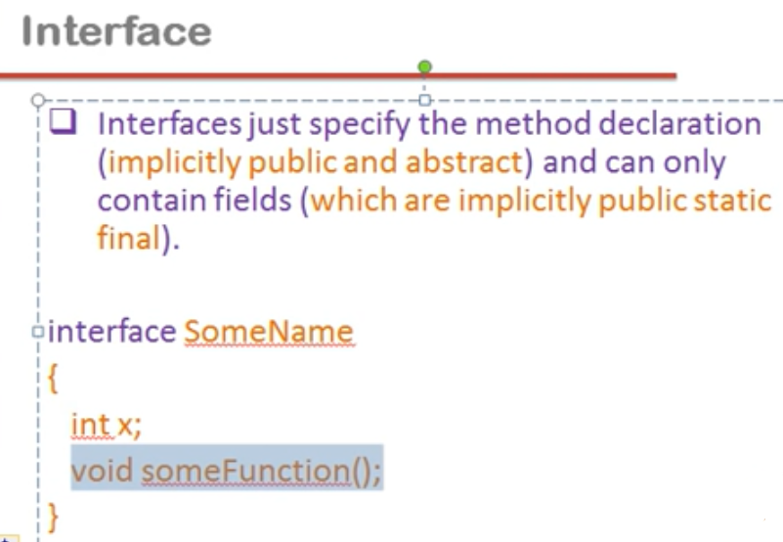

Slide 113
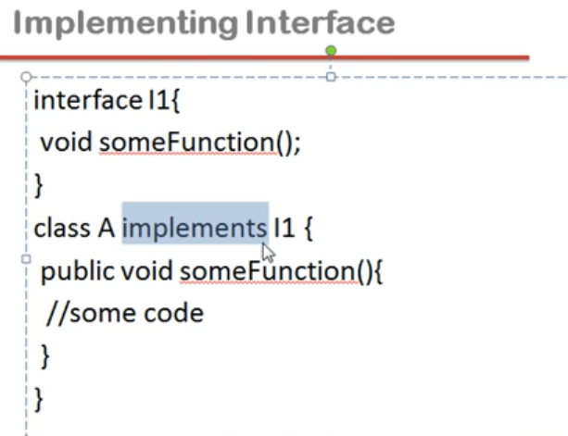

Slide 114
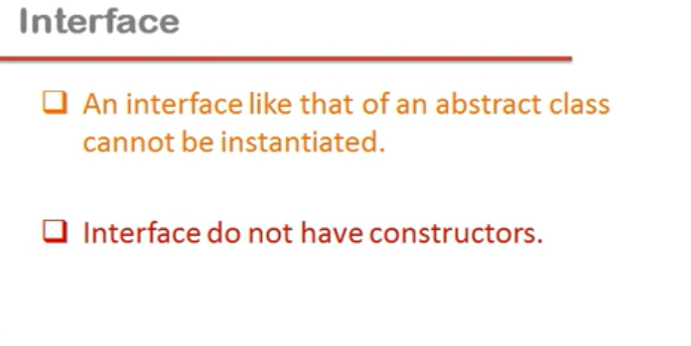

Slide 115
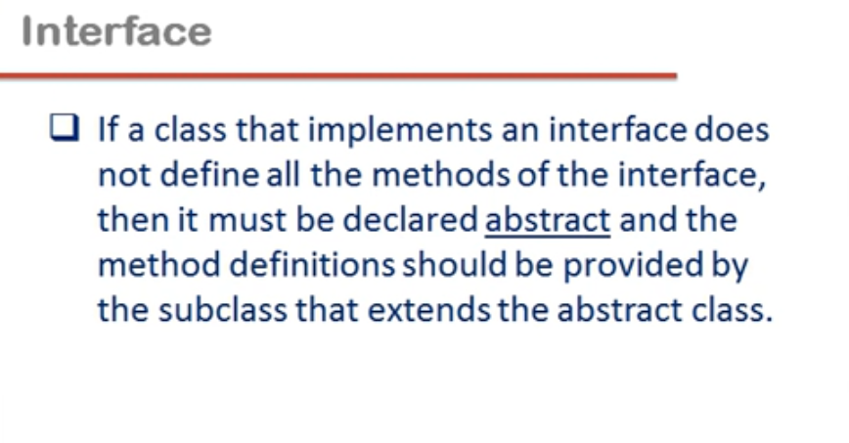

Slide 116
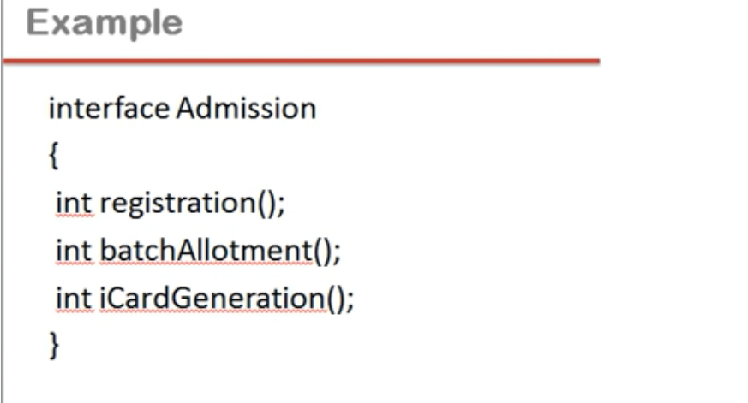

Slide 117
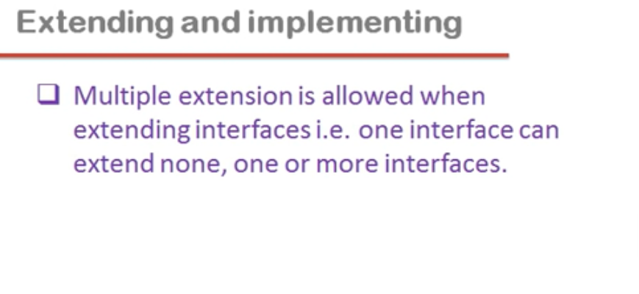

Slide 118
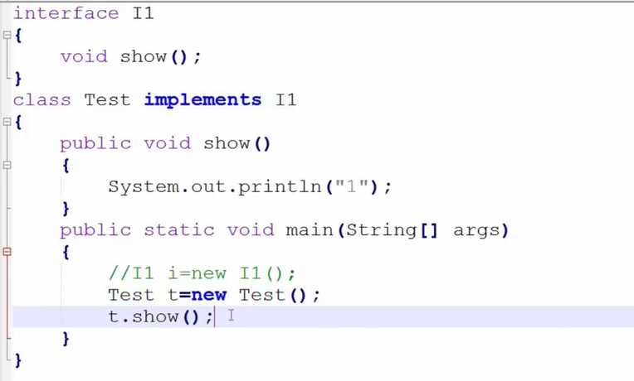

Slide 119
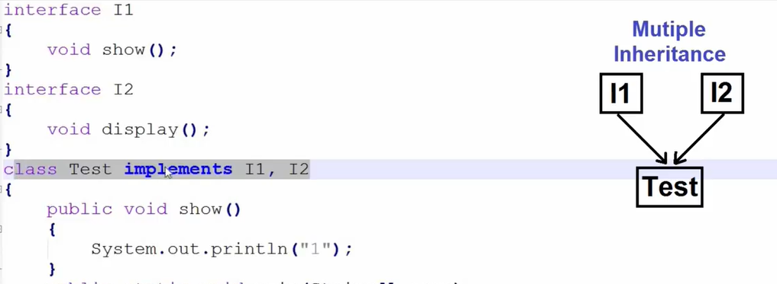

Slide 120
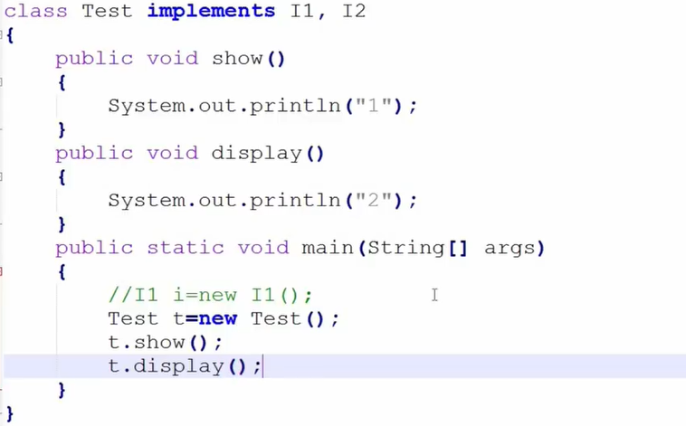

Slide 121
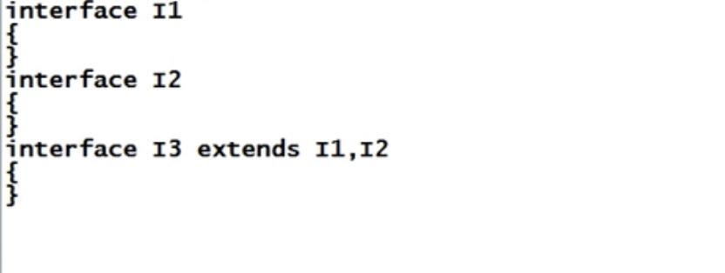

Slide 122
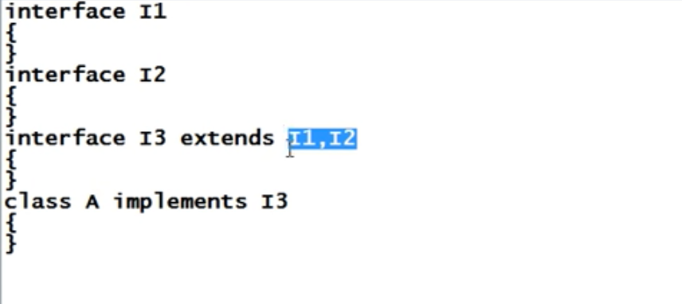

Slide 123
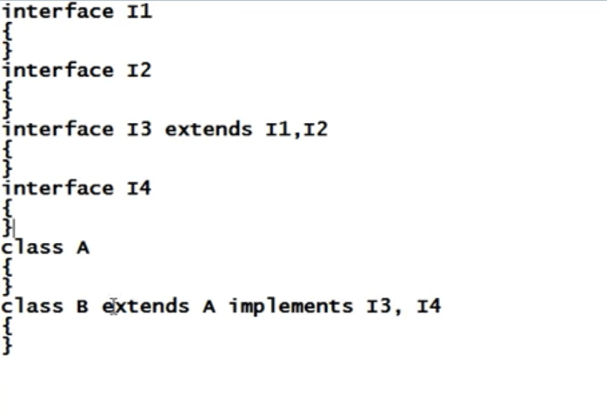

Slide 124
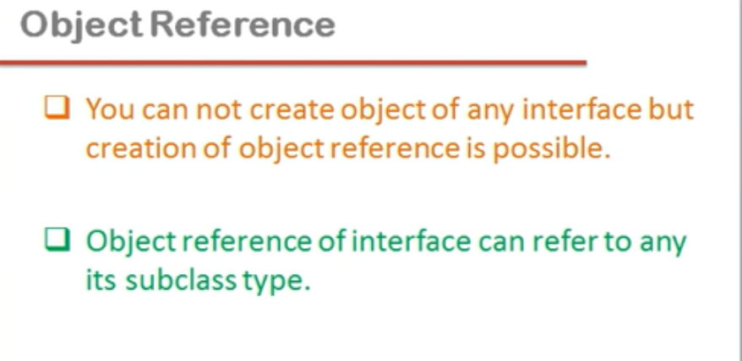

Slide 125
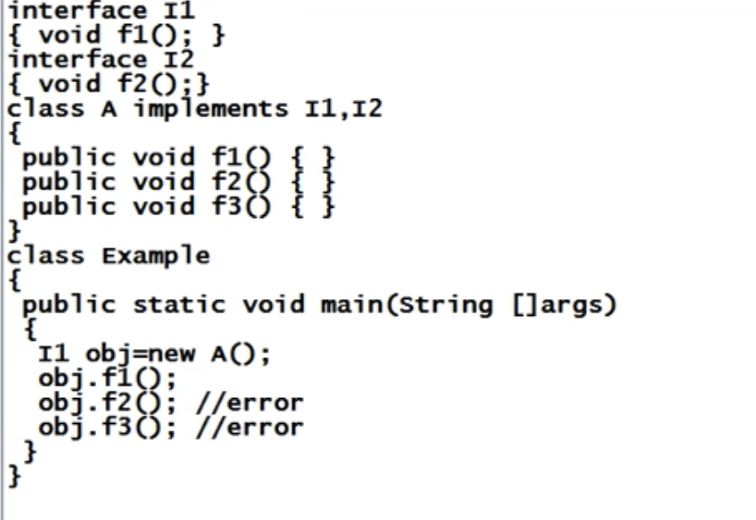

Slide 126
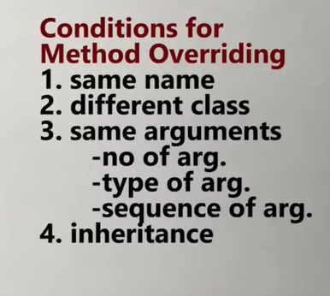

Slide 127
Polymorphism
Greek word, and the meaning is- many or multiple forms.
Same operations behave differently in different contexts.
The operation “area “ is same but it will take different forms depending upon type & number of arguments passed to area.

Slide 128
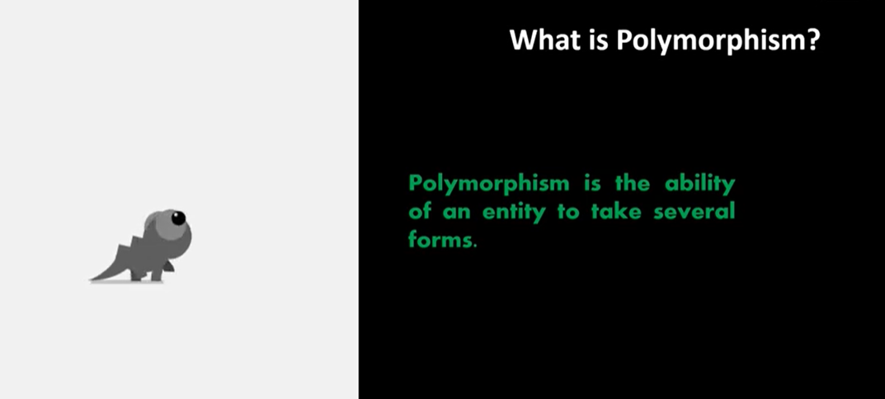

Slide 129
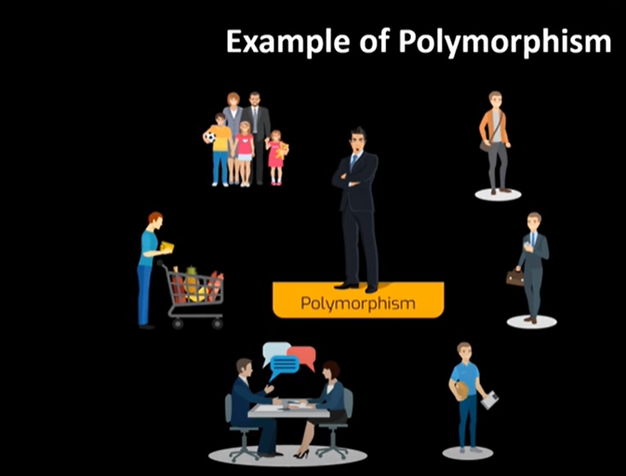

Slide 130


Slide 131


Slide 132


Slide 133


Slide 134
Polymorphism
int add (int a, int b);
int add (int a, int b, int c);
float add (int x, float y);
float add (float p, int q);
float add (float x, float y);

Slide 135
void max(int x, int y)
{
if(x>y)
cout<<x<<"is greater";
else
cout<<y<<"is greater";
}
void max(float x, float y)
{
if(x>y)
cout<<x<<"is greater";
else
cout<<y<<"is greater";
}
void max(char x, char y)
{
if(x>y)
cout<<x<<"is greater";
else
cout<<y<<"is greater";
}
int main()
{
max(‘A', ‘Z');
max(3, 7);
max(44.66, 22.13);
}

Slide 136


Slide 137


Slide 139


Slide 140


Slide 141


Slide 142
Overloading vs. Overriding
Don't confuse the concepts of overloading and overriding
Overloading deals with multiple methods with the same name in the same class, but with different signatures
Overriding deals with two methods, one in a parent class and one in a child class, that have the same signature
Overloading lets you define a similar operation in different ways for different data
Overriding lets you define a similar operation in different ways for different object types

Slide 143
class test{
void show()
{
System.out.println("1");
}
void show()
{
System.out.println("2");
}
}
public class Main{
public static void main(String[] args) {
test ob=new test();
ob.show(); //syntax error
}
}

Slide 144


Slide 145
class test
{
void show(int a)
{
System.out.println("1");
}
void show()
{
System.out.println("2");
}
}
public class Main
{
public static void main(String[] args) {
test ob=new test();
ob.show(); //output: 2
}
}

Slide 146
class test
{
void show(int a)
{
System.out.println("1");
}
void show()
{
System.out.println("2");
}
}
public class Main
{
public static void main(String[] args) {
test ob=new test();
ob.show(100); //Output :1
}
}

Slide 147
class test
{
void show(int a,int b)
{
System.out.println("1");
}
void show(int a)
{
System.out.println("2");
}
}
public class Main
{
public static void main(String[] args) {
test ob=new test();
ob.show(10,20);
}
}

Slide 148
class test
{
void show(int a,String b)
{
System.out.println("1");
}
void show(String a,int b)
{
System.out.println("2");
}
}
public class Main
{
public static void main(String[] args) {
test ob=new test();
ob.show("scoe“,500); //output:2
}
}

Slide 149
class test
{
void show(int a,String b)
{
System.out.println("1");
}
void show(String a,int b)
{
System.out.println("2");
}
}
public class Main
{
public static void main(String[] args) {
test ob=new test();
ob.show(100,"scoe"); //output:1
}
}

Slide 150
class test
{
void show(int a)
{
System.out.println("1");
}
void show(String a)
{
System.out.println("2");
}
}
public class Main
{
public static void main(String[] args) {
test ob=new test();
ob.show("scoe"); //output:2
}
}

Slide 151
class test
{
void show(int a)
{
System.out.println("1");
}
void show(String a)
{
System.out.println("2");
}
}
public class Main
{
public static void main(String[] args) {
test ob=new test();
ob.show(100); //output:1
}
}

Slide 152


Slide 153


Slide 154


Slide 155


Slide 156


Slide 157


Slide 158
public class Main
{
public static void main(String[] args)
{
System.out.println("1");
Main ob=new Main();
ob.main(10);
}
public static void main(int a)
{
System.out.println("2");
}
}

Slide 159


Slide 160


Slide 161


Slide 162


Slide 163


Slide 164


Slide 165


Slide 166


Slide 167
Class Shape
area( )
Circle object
area( circle)
triangle object
area(triangle)
rectangle object
area(rectangle)
Virtual function

Slide 168


Slide 169


Slide 170


Slide 171


Slide 172


Slide 173


Slide 174


